Slide 1
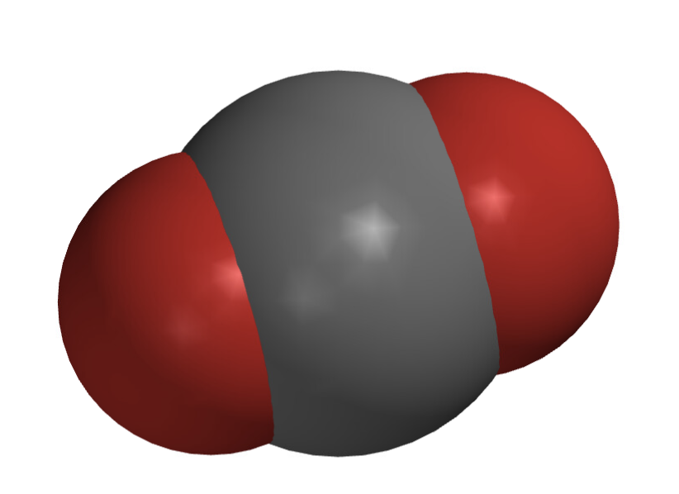
Let’s see how we can describe what happens when carbon (like charcoal) burns

Slide 2
Let’s see how we can describe what happens when carbon (like charcoal) burns
We write this symbolically as a chemical equation
C + O₂ → CO₂

Slide 3
Other possible combinations
But what if two carbon atoms combine with each O₂?
What’s the chemical equation?

Slide 4
Other possible combinations
But what if two carbon atoms combine with each O₂?
What’s the chemical equation?
2C + O₂ → 2CO

Slide 5
Other possible combinations
But what if two carbon atoms combine with each O₂?
What’s the chemical equation?
2C + O₂ → 2CO
The “2” in front of C and CO are called stoichiometric coefficients
If there’s no number, it means the stoichiometric coefficient equals 1

Slide 6
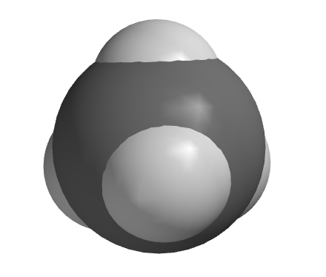
Let’s see how we can describe what happens when methane burns
Checklist … Same number of atoms left and right?
Chemical Equation …

Slide 7
Let’s see how we can describe what happens when methane burns
Checklist … Same number of atoms left and right?
Yup
Chemical Equation …

Slide 8
Let’s see how we can describe what happens when methane burns
Checklist … Same number of atoms left and right?
Yup
Chemical Equation …
__ CH₄ + __ O₂ → __ CO₂ + __ H₂O

Slide 9
Let’s see how we can describe what happens when methane burns
Checklist … Same number of atoms left and right?
Yup
Chemical Equation …
1 CH₄ + 2 O₂ → 1 CO₂ + 2 H₂O

Slide 10
Let’s see how we can describe what happens when methane burns
Checklist … Same number of atoms left and right?
Yup
Chemical Equation …
CH₄ + 2O₂ → CO₂ + 2H₂O

Slide 11
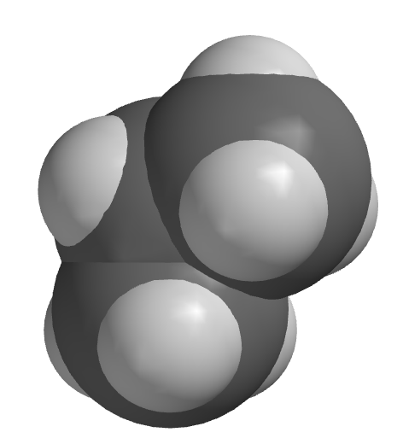
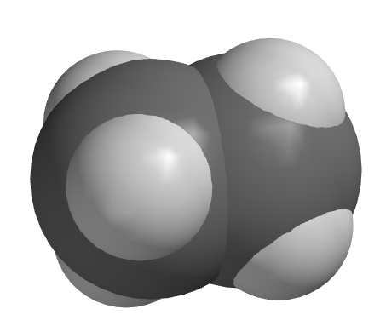
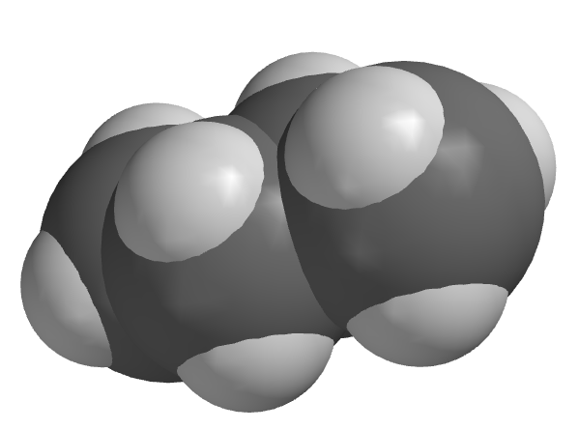
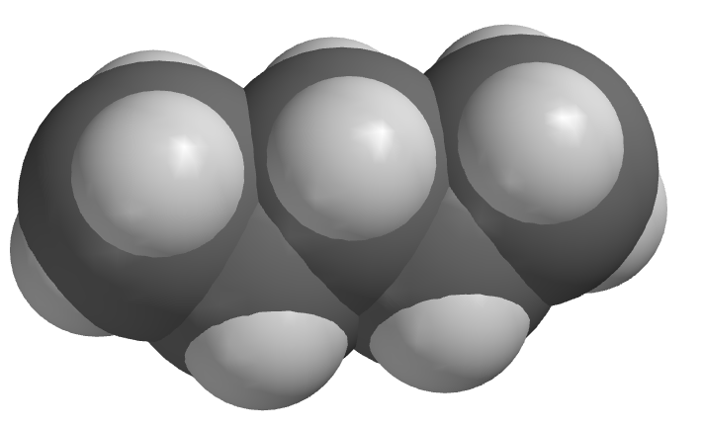
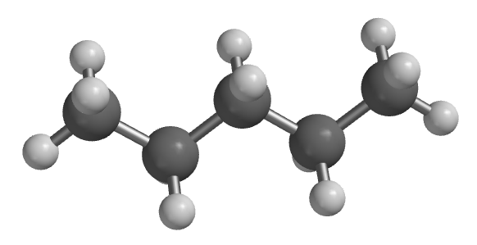
There are other hydrocarbons besides methane
methane

Slide 12
There are other hydrocarbons besides methane
ethane
methane
propane
pentane
butane

Slide 13
There are other hydrocarbons besides methane
ethane
methane
propane
pentane
butane
“Mary eats plums before pizza”

Slide 14
When other hydrocarbons burn …
2C₂H₆ +7O₂ → __ CO₂ + __ H₂O

Slide 15
When other hydrocarbons burn …
ethane
ethane
2C₂H₆ +7O₂ → __ CO₂ + __ H₂O

Slide 16
When other hydrocarbons burn …
ethane
ethane
2C₂H₆ +7O₂ → __ CO₂ + __ H₂O
4 of these

Slide 17
When other hydrocarbons burn …
ethane
ethane
2C₂H₆ +7O₂ → __ CO₂ + __ H₂O
4 of these
6 of these

Slide 18
When other hydrocarbons burn …
ethane
ethane
2C₂H₆ +7O₂ → 4CO₂ + 6H₂O
4 of these
6 of these

Slide 19
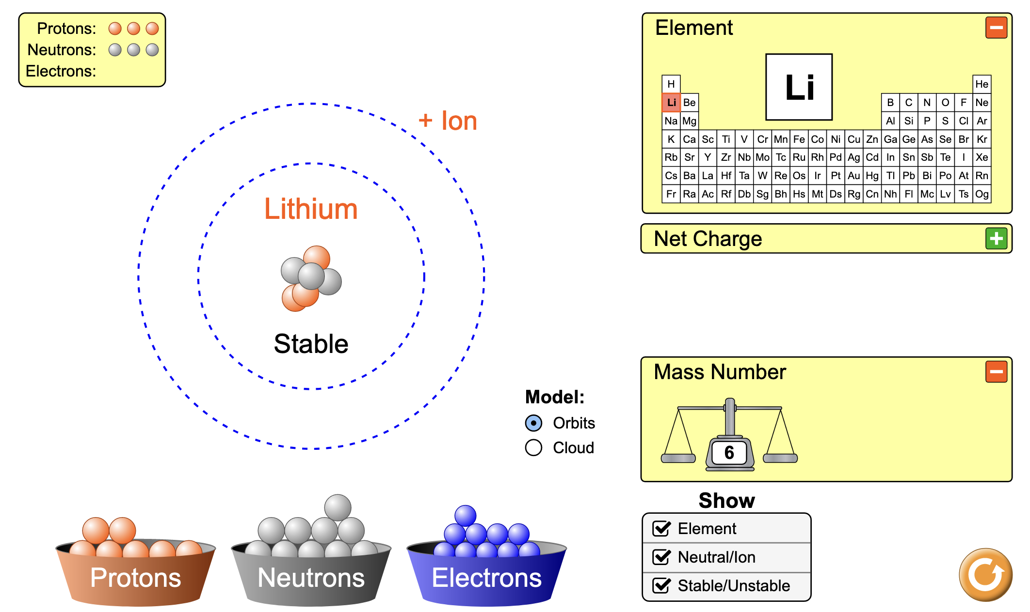
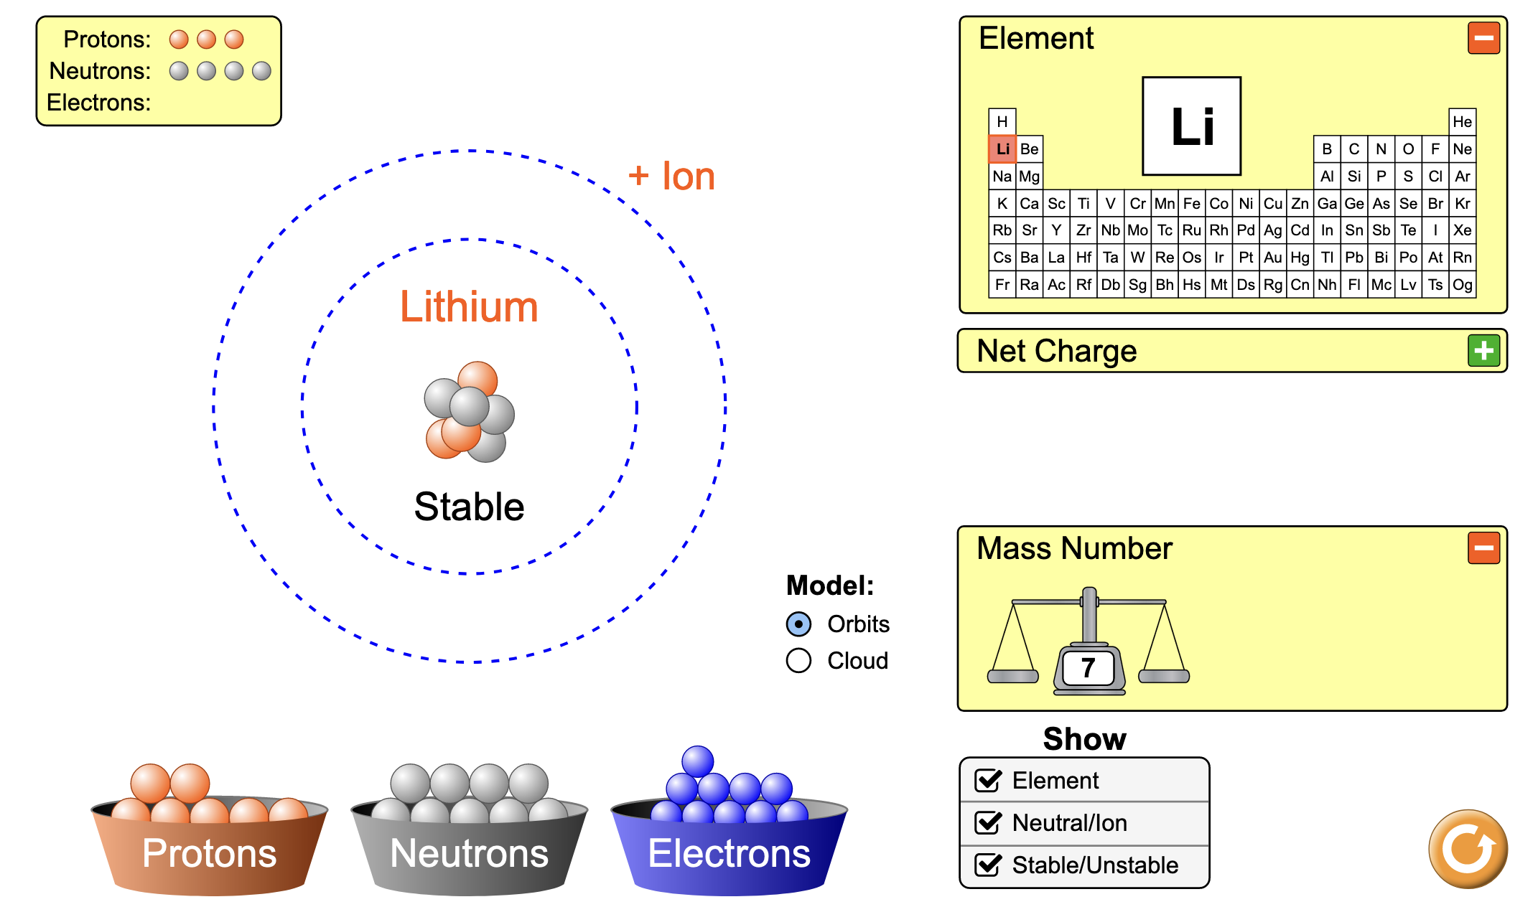
About the masses of gases: the Atomic Weight
We said last week that the #neutrons + #protons is the mass number of an isotope.
Shorthand: ⁶Li and ⁷Li

Slide 20
About the masses of gases: the Atomic Weight
So what’s that number below Li in the periodic table?
Answer: an average over the isotopes that occur on Earth!
We’ll call this value the Atomic Weight, symbolized by AW.
Based on the atomic weight, which do you suppose is more prevalent on Earth, ⁶Li or ⁷Li?

Slide 21
About the masses of gases: the Atomic Weight
So what’s that number below Li in the periodic table?
Answer: an average over the isotopes that occur on Earth!
We’ll call this value the Atomic Weight, symbolized by AW.
Based on the atomic weight, which do you suppose is more prevalent on Earth, ⁶Li or ⁷Li?
Observed abundances:
⁶Li – 8%
⁷Li – 92%

Slide 22
About the masses of gases: the Atomic Weight
Magnesium has three naturally occurring stable isotopes on Earth:
²⁴Mg
²⁵Mg
²⁶Mg
Based on the atomic weight, which do you suppose is more prevalent on Earth?

Slide 23
About the masses of gases: the Atomic Weight
Magnesium has three naturally occurring stable isotopes on Earth:
²⁴Mg
²⁵Mg
²⁶Mg
Based on the atomic weight, which do you suppose is more prevalent on Earth?
Observed abundances:
²⁴Mg – 79%
²⁵Mg – 10%
²⁶Mg – 11%

Slide 24
Atomic weights of molecules
AW = Atomic Weight (of an atom)
MW = Molecular Weight (of a molecule)
N has AW = 14.01, so
N₂ has MW = _______
C has AW = 12.01, and
H has 1.008, so
C₃H₈ has MW = _______

Slide 25
Atomic weights of molecules
AW = Atomic Weight (of an atom)
MW = Molecular Weight (of a molecule)
N has AW = 14.01, so
N₂ has MW = 28.02
C has AW = 12.01, and
H has 1.008, so
C₃H₈ has MW = 44.09

Slide 26
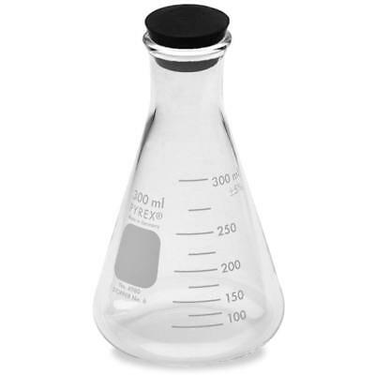
Looking ahead: How to tell the difference between gas samples (when they look the same)
H₂(g)
N₂(g)
C₃H₈(g)
Wouldn’t it be cool if you could tell the difference between these by weighing them?
Well, you can!

Slide 27
Avogadro’s Law
H₂(g)
N₂(g)
C₃H₈(g)
Here’s a cool thing about gases: Equal volumes of gas (at the same temperature and pressure) contain the same number of molecules
This is called Avogadro’s Law
Assuming these three flasks really do have the same volume, it must mean that the flask that weighs the most must contain the gas whose molecules have the greatest mass! But this requires that we be a little more careful about the masses of atoms and molecules

Slide 28
Looking ahead: How to tell the difference between gas samples (when they look the same)
H₂(g)
N₂(g)
C₃H₈(g)
MW
2.016
28.02
44.09
Since these three flasks have the same number of molecules, it must be that the heaviest flask has the C₃H₈, the lightest has H₂!

